Slide 1

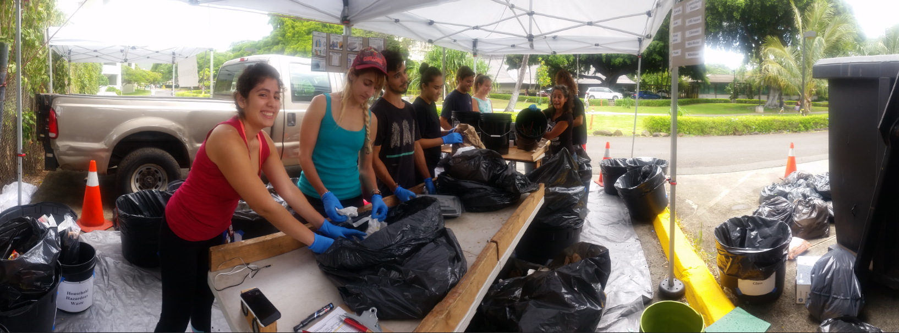


WASTE AUDIT CHALLENGE
Nicole Chatterson, Campus as a Living Lab Coordinator
University of Hawaiʻi System Office of Sustainability

Slide 2





1 TON OF TRASH
The Problem
70 TONS OF UPSTREAM WASTE

Slide 3
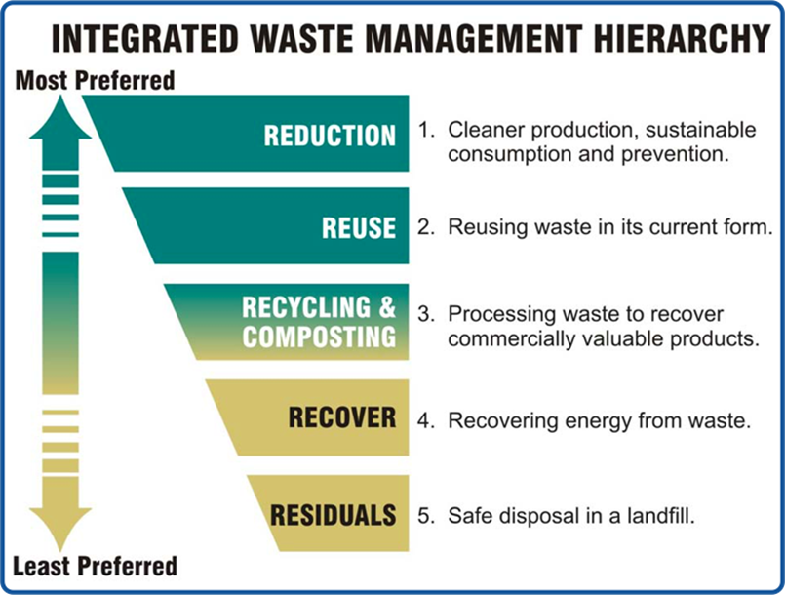
PROACTIVE/UPSTREAM
REACTIVE/
DOWNSTREAM

Slide 4
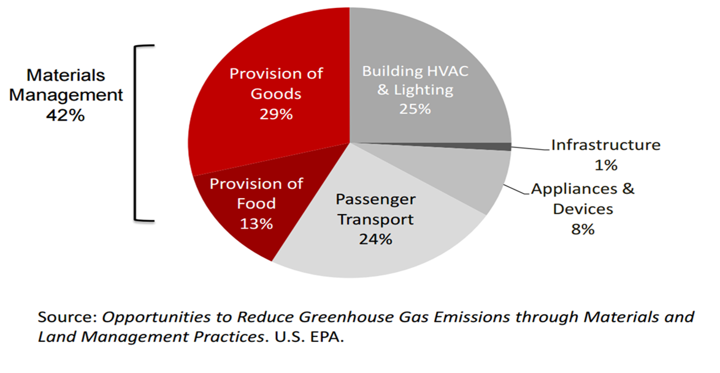
Production, Use and Disposal of Goods & Food = 42% of GHG Emissions

Slide 5
By 2040 “the atmosphere will warm up by as much as 2.7 degrees above pre-industrial levels, inundating coastlines and intensifying droughts and poverty.”

Slide 6
UH Executive Sustainability Policy
1. Commit to minimize greenhouse emissions and become carbon neutral by 2050…
6. Establish metrics and reporting mechanisms to track total solid waste generated, waste source reduction, recycling, re-use of materials, green waste, food waste, electronic waste, use of single use plastics and bioconversion…..
12. Establish a Green Purchasing Policy….

Slide 7
What is a waste audit?

Slide 8
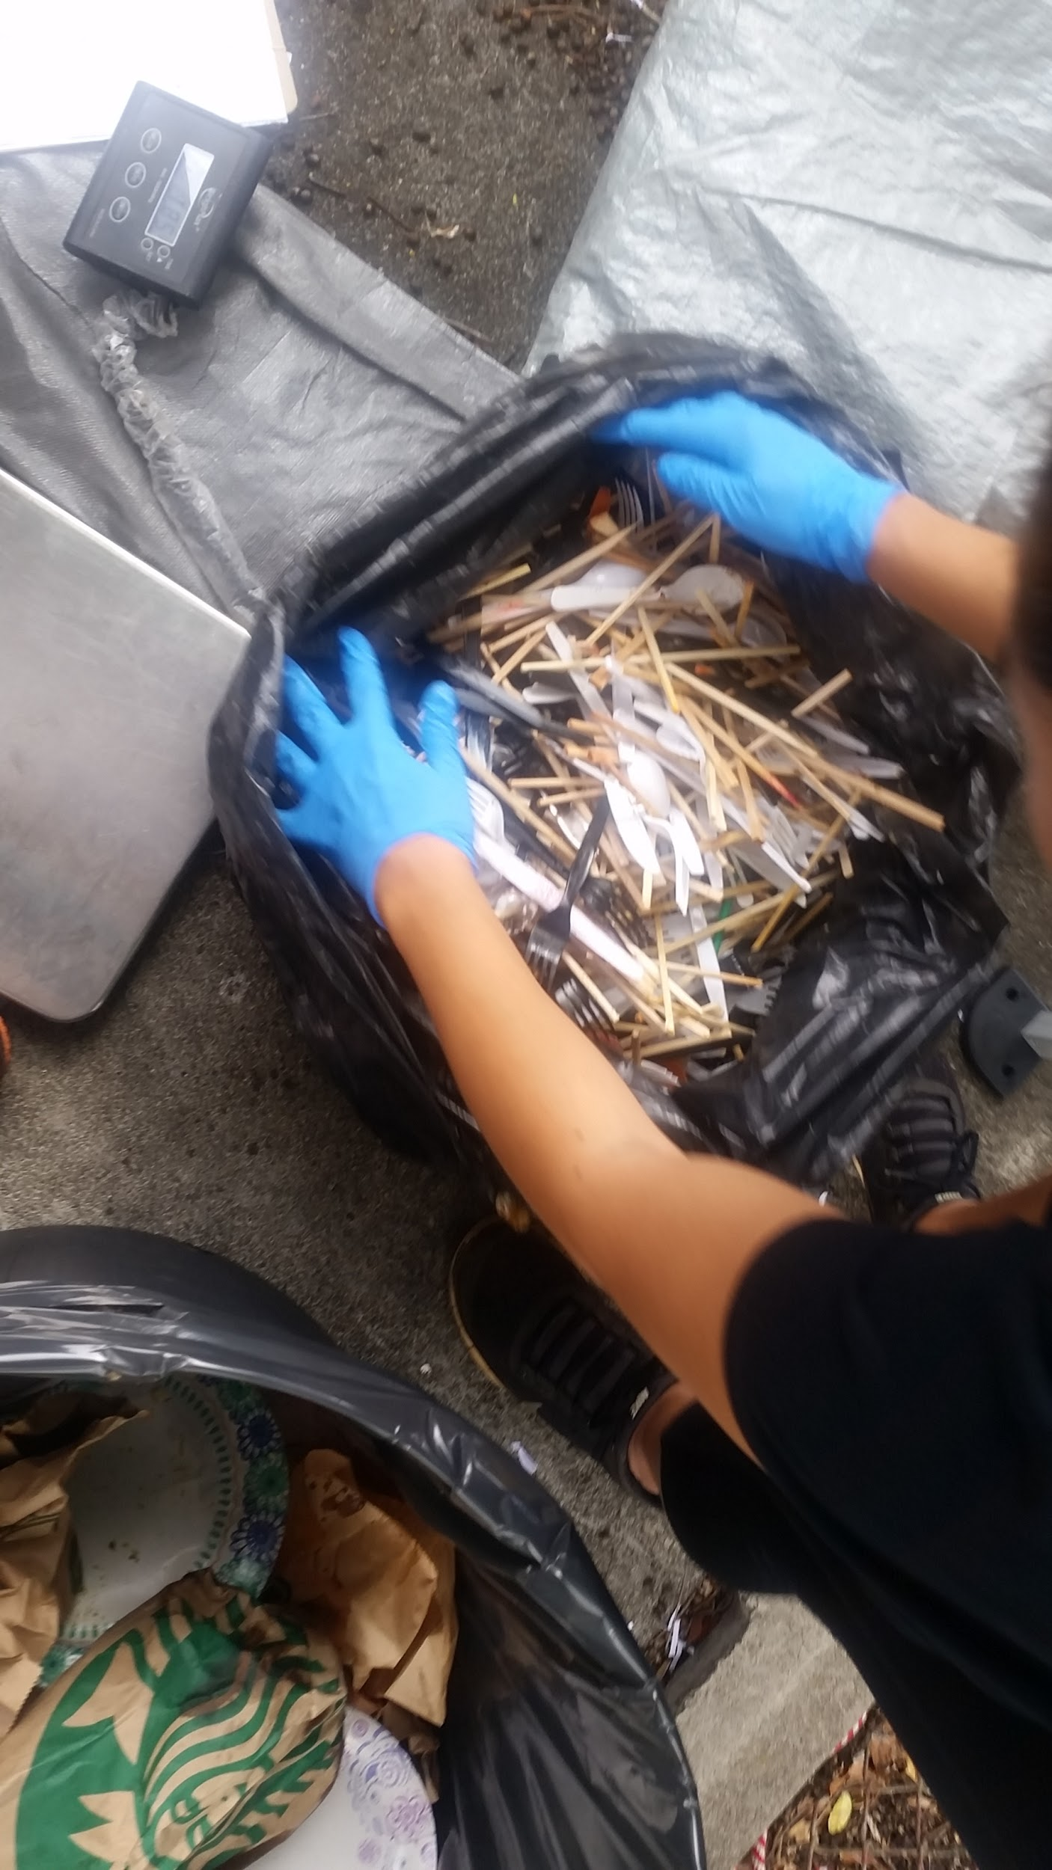
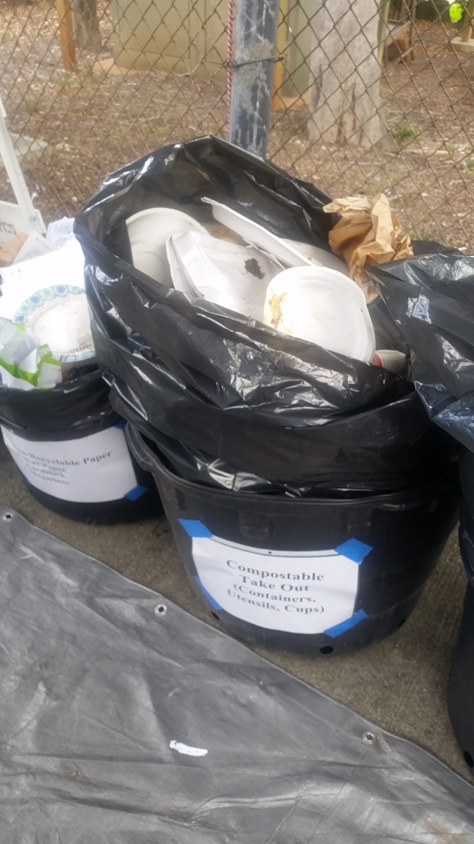

Slide 9
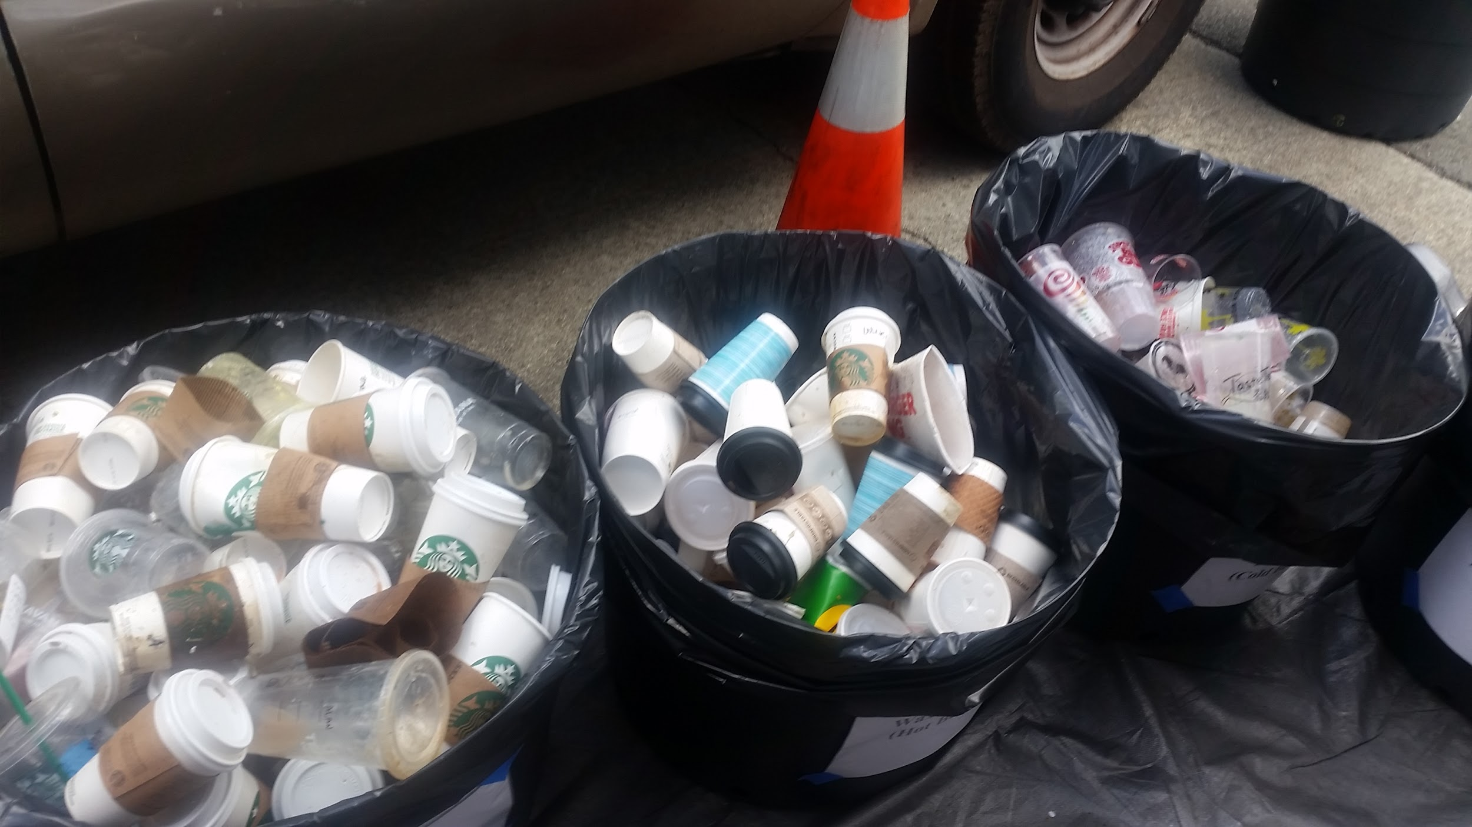

Slide 10
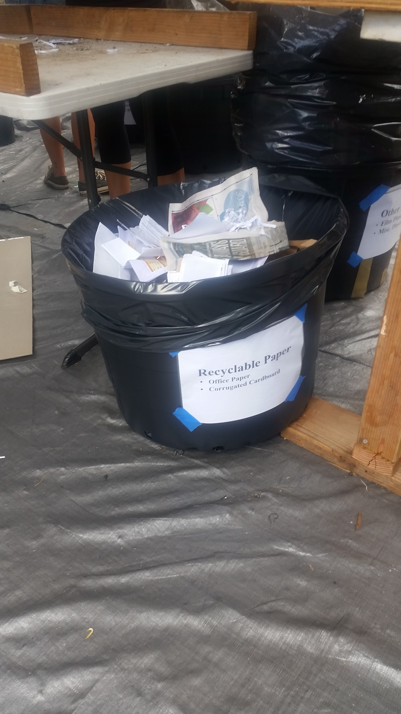
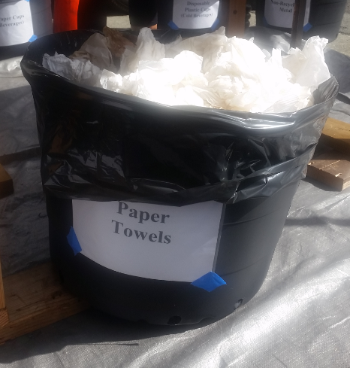

Slide 11
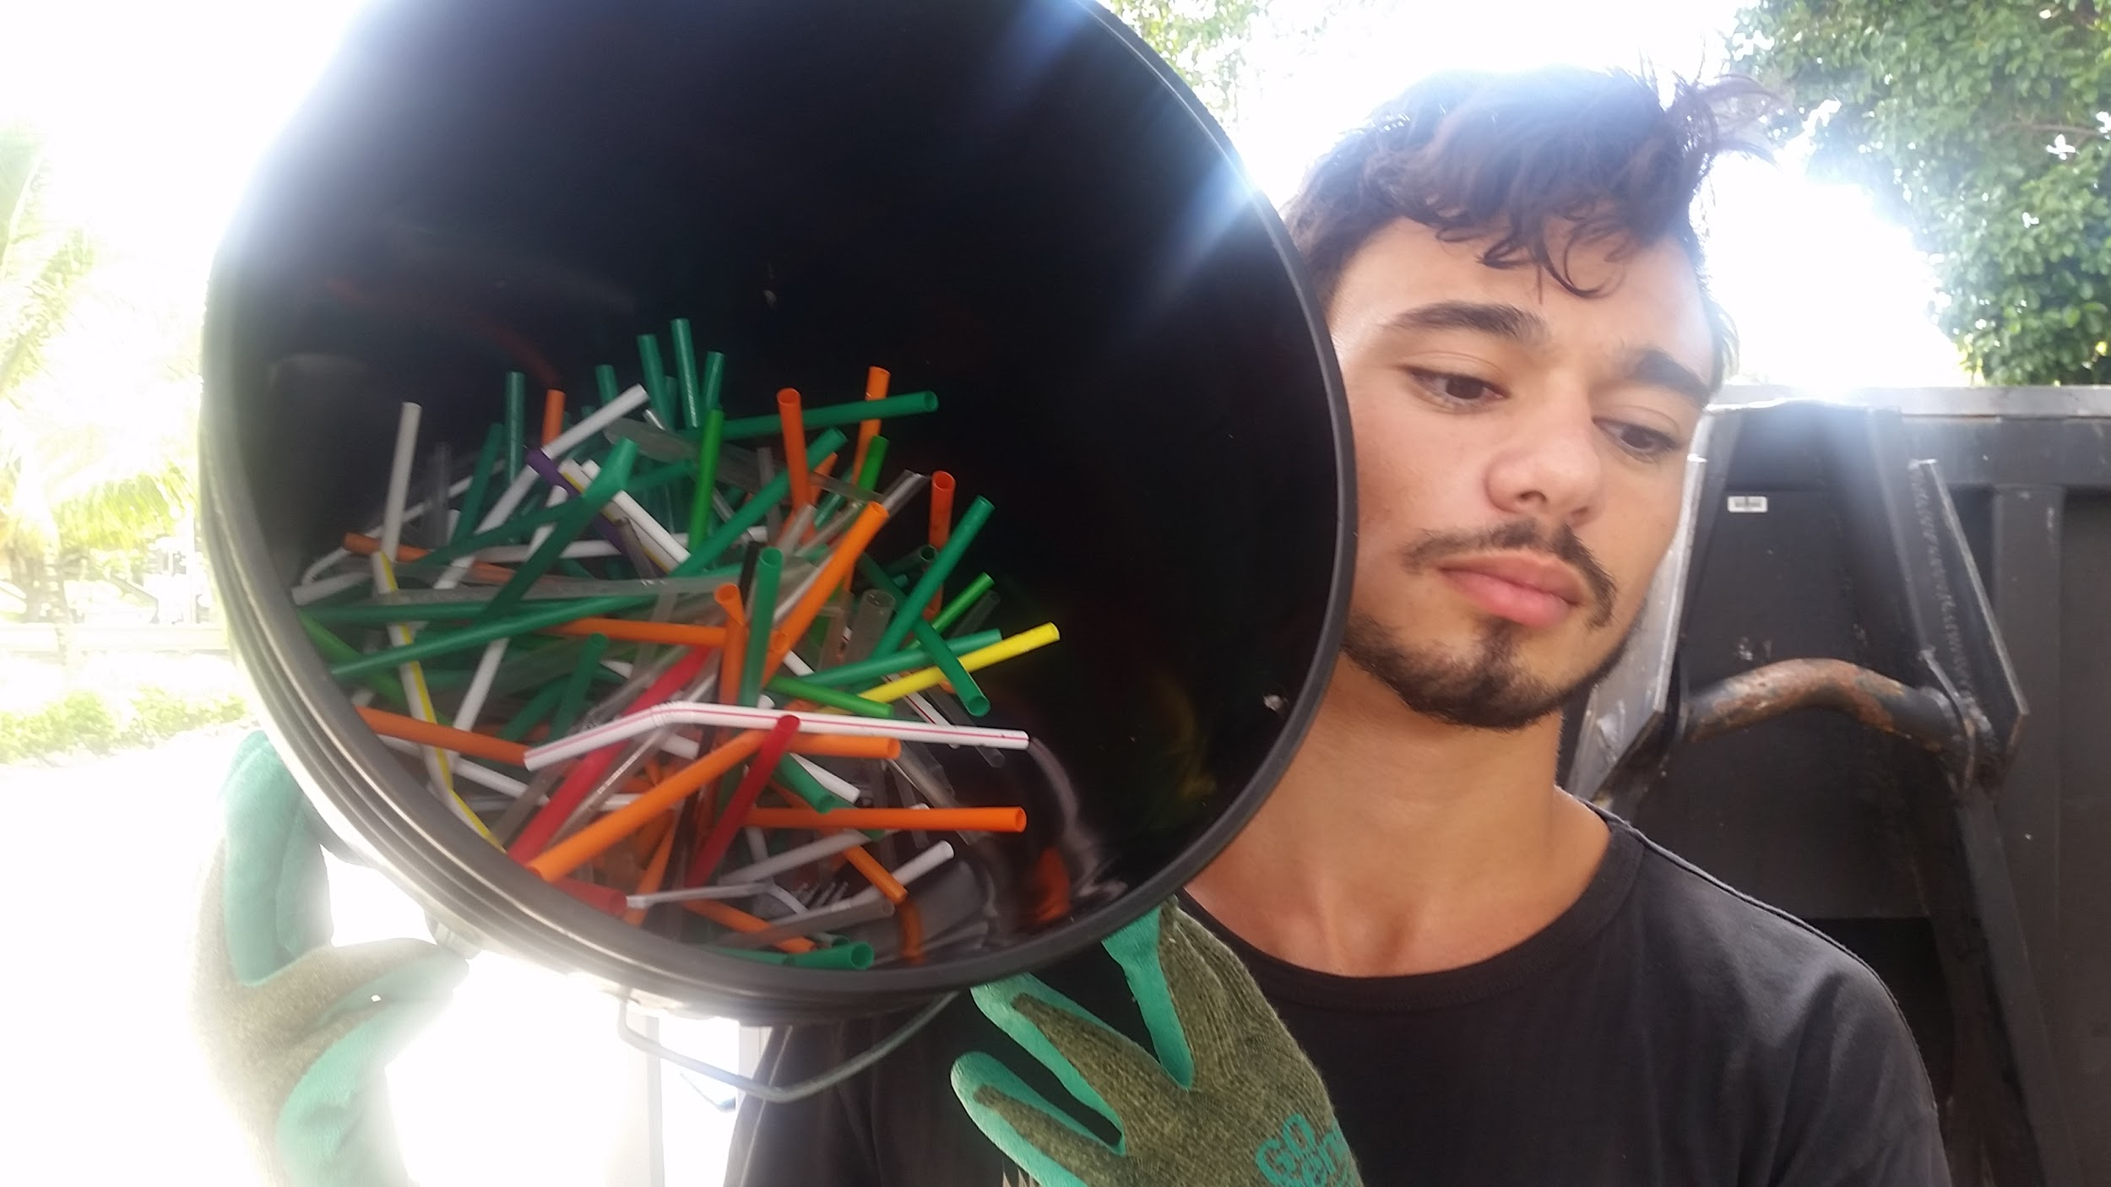

Slide 12
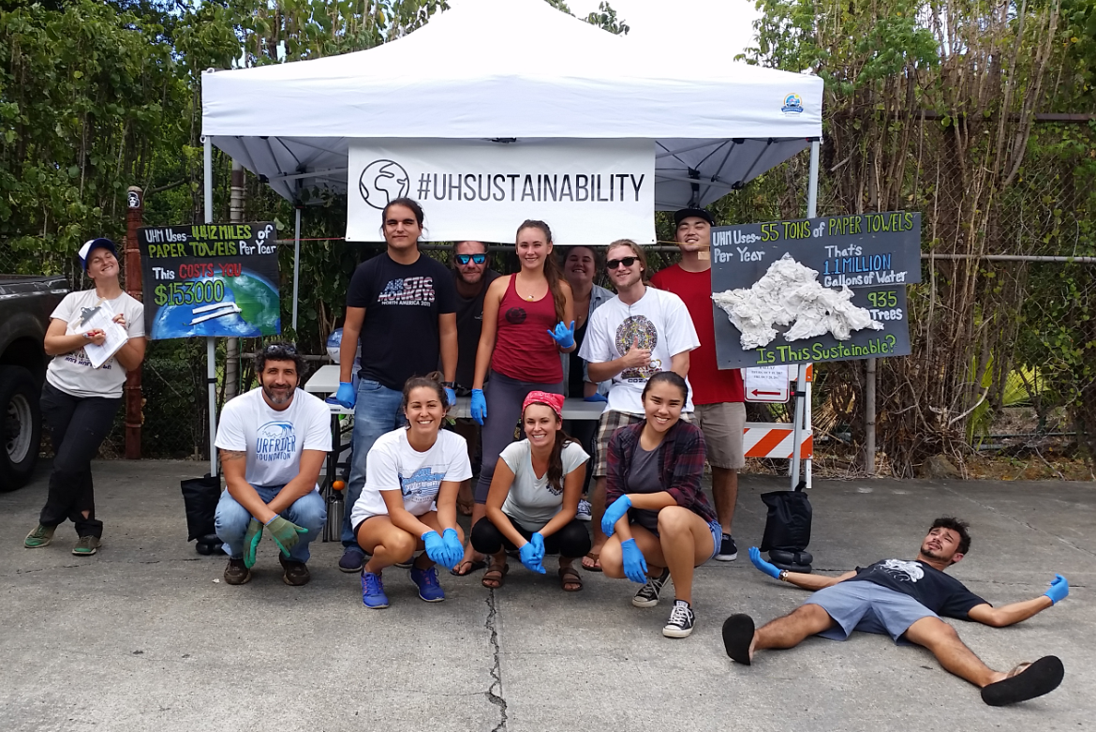

Slide 13
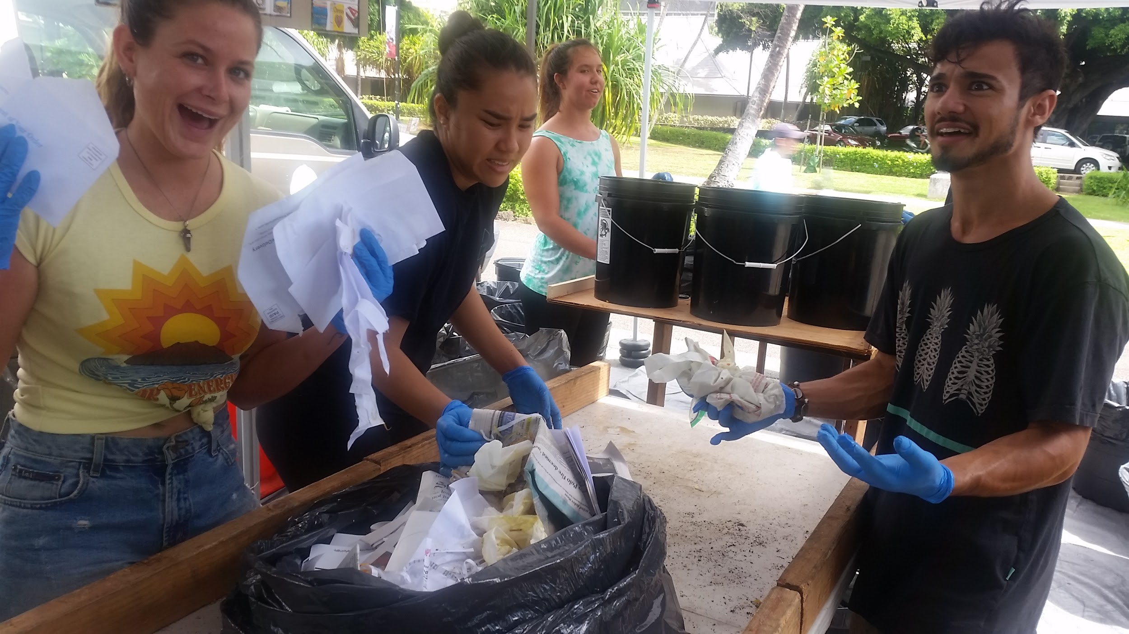
The Challenge

Slide 14
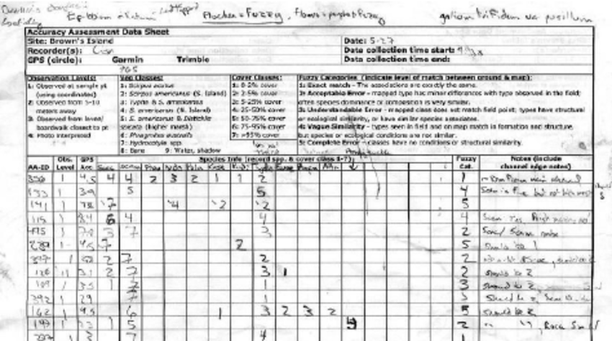

Slide 15
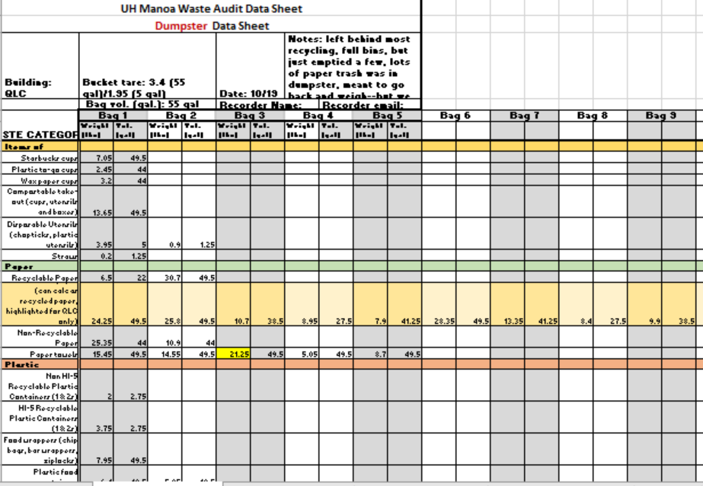
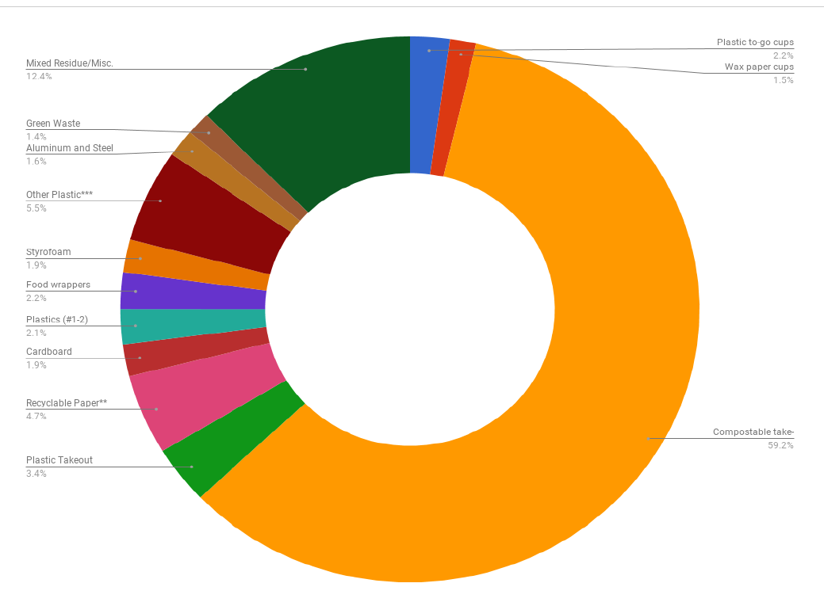
Notes:
Bi-annual audits, across all 10 campuses….need a student friendly way to input the data during an exhausting, high turnover situation...and ideally a backend component that can help with campus specific and inter-campus reporting. Something compile, house, visualize, share, compare, and track audit to inform intervention

Slide 16
“YOU DONʻT FILTER SMOKESTACKS AND WATER. INSTEAD YOU, PUT THE FILTER IN YOUR HEAD AND DESIGN THE PROBLEM OUT OF EXISTENCE.”
---William McDonough
Cradle to Cradle, 2002

Slide 17
